Slide 1
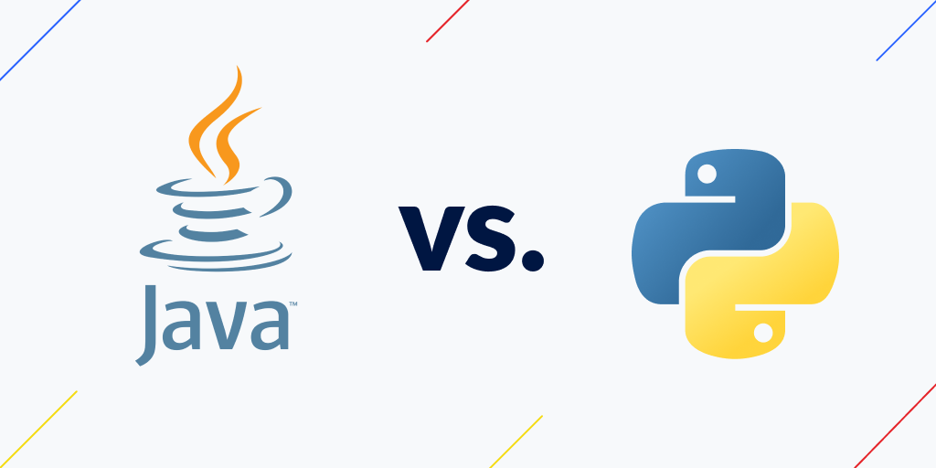
Python Java Understanding Characteristics, Use Cases, And Advantages
VS
Presenter: Romeo Dandison

Slide 2
Table of contents
Introduction
Python
01
02
Java
How they work
03
04
Concept of programming languages
Overview of Python
Overview of Java
Python vs Java

Slide 3
Table of contents
Comparison
Conclusion
05
07
Python vs Java
References
05

Slide 4
01
Introduction
Concept of Programming Language

Slide 5
What is Programming Language?
A programming language is a set of instructions that enables humans to communicate commands to a computer in software development.
Python and Java are examples of Application-based Programming languages. They are ranked 3rd and 4th respectively on the most popular programming language among programmers for 2024 (statista.com)

Slide 6
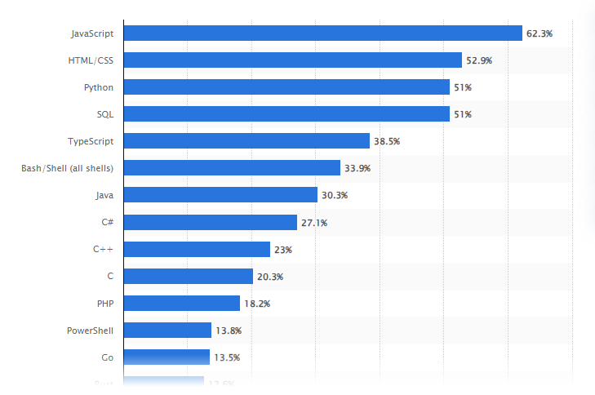
Most used programming languages among developers worldwide as of 2024 (statista.com)

Slide 7
02
Python
Overview of Python

Slide 8
Overview of Python
Python is a high-level, interpreted, object-oriented programming language with dynamic semantics created by Guido van Rossum. Originally released in 1991, Python is a dynamically typed and garbage-collected language designed to be highly readable. Its demand is growing at a very rapid pace due to its vast use cases in Modern Technological fields like Data Science, Machine learning, and Automation Tasks.

Slide 9
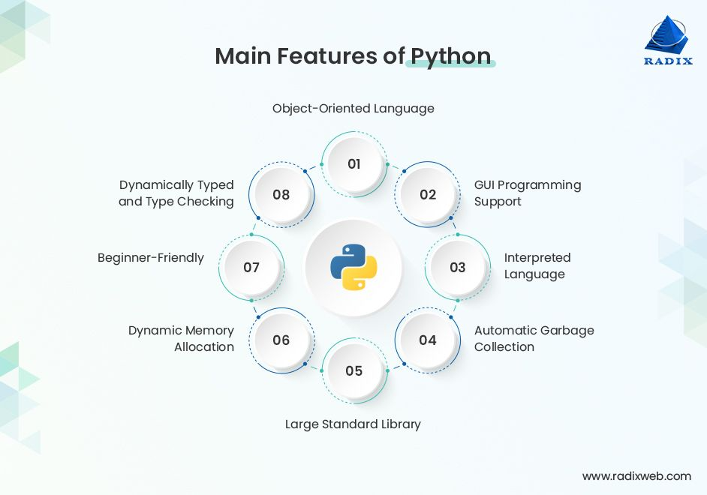
Features of Python

Slide 10
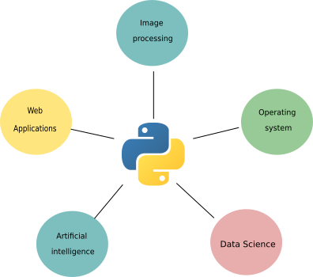
Applications of Python

Slide 11
Advantages of Python
Easy to learn, read, and understand
Versatile and open-source
Improves productivity
Supports libraries
Huge library
Strong community
Interpreted language

Slide 12
Disadvantages of Python
Slow speed
Memory intensive
Weak in mobile computing
Runtime errors
Not optimized for database access
No multithreading support

Slide 13
03
Java
Overview of Java

Slide 14
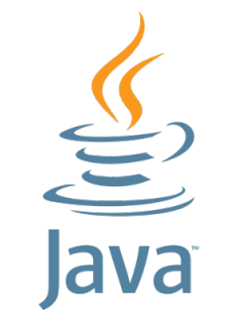
Overview of Java
Java is a high-level, class-based, object-oriented programming language that was originally developed by Sun Microsystems and released in 1995. It is known for its versatility, portability, and strong community support. Java is ranked 4th on TIOBE-INDEX for August, 2024.

Slide 15
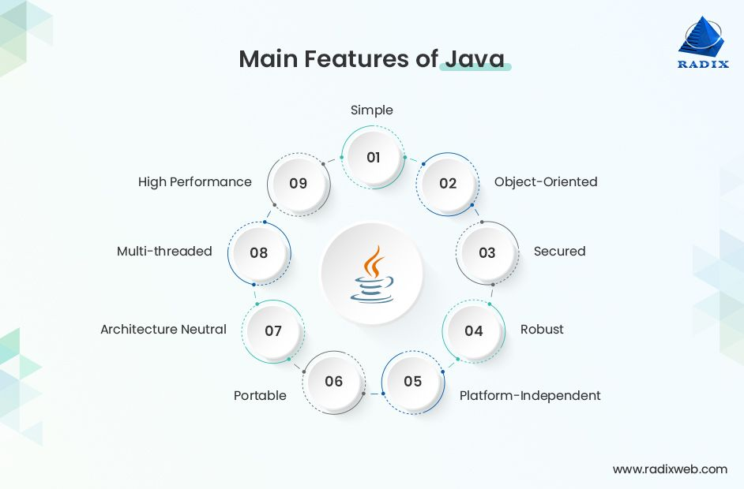
Features of Java

Slide 16
Applications of Java
Game development
Cloud computing
Big data
Artificial intelligence
IOT applications
Chatbots and other marketing tools

Slide 17
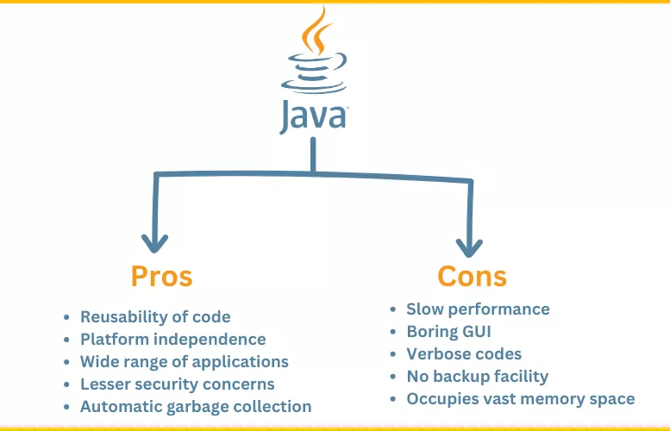
Pros and Cons of Java

Slide 18
04
Python vs Java
How they work

Slide 19
Working Model of Python vs Java

Slide 20
04
Python vs Java
Comparison

Slide 21
Python vs Java comparison table
 | Python | Java
Compilation | Interpreted language | Complied language
Static/Dynamic | Dynamic typed programming language | Static-typed programming language
Code | Fewer lines of code | Long lines of code
Performance | Dynamic and slower | Static and faster

Slide 22
Python vs Java comparison table
 | Python | Java
Learning curve and code readability | Easier to learn and read | Difficult to learn and read
Classes | Refers to variables directly | Uses getter and setter functions
Architecture | Translates into machine-independent byte code | JVX runs codes and converts bytecode into machine-readable language
Best Feature | Scientific and numeric computing, especially Machine learning | GUI apps and web app services

Slide 23
Python vs Java comparison table
 | Python | Java
Game development Engines | Cocos, Pandas3D | JMonkey Engine
Backend framework | Django, flask | Spring, Blade
Database support | Weak connectivity | Stable connectivity

Slide 24
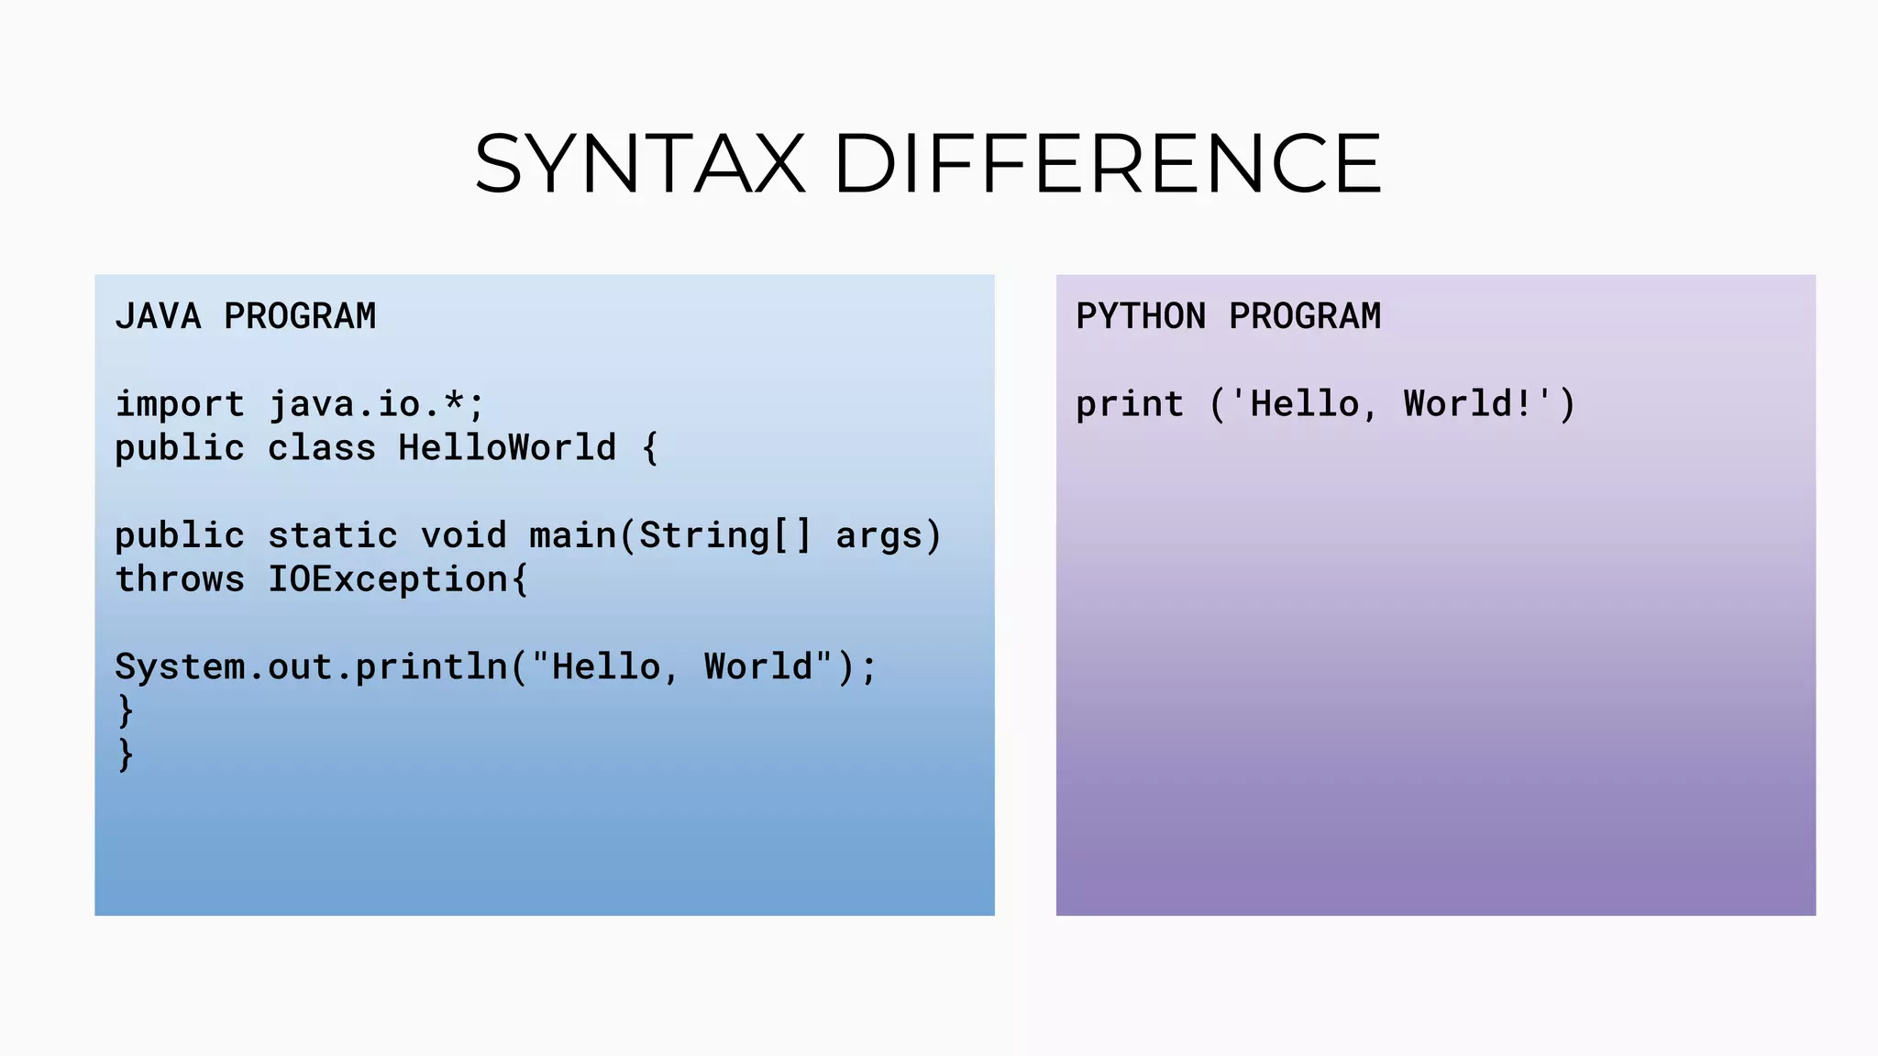
Python vs Java comparison table

Slide 25
Conclusion
We can conclude that both Python and Java languages have their strengths and weaknesses. The choice completely depends on your project requirements, your familiarity with the languages, and the ecosystem you intend to work within.

Slide 26
References
https://github.com/resources/articles/software-development/what-is-a-programming-language retrieved on 20th August, 2024
Programming language index - https://www.tiobe.com/tiobe-index/ retrieved on 22nd August, 2024.
https://radixweb.com/blog/python-vs-java retrieved on 24th August, 2024.

Slide 27
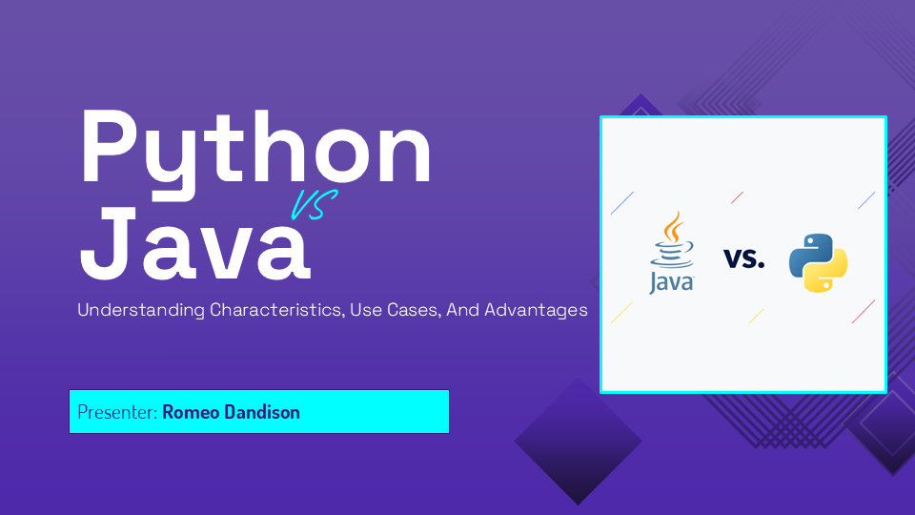
Thank you

